Slide 1


Slide 2
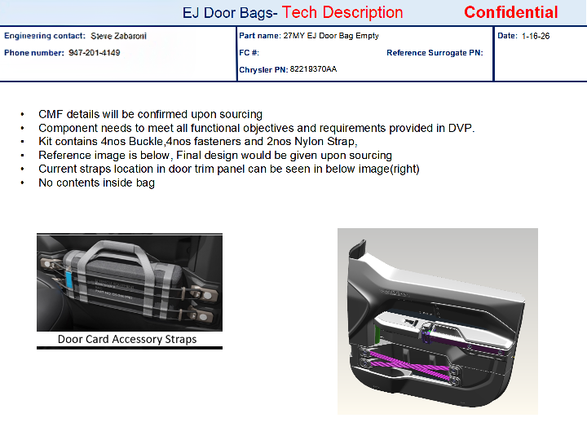
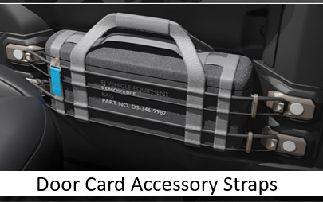
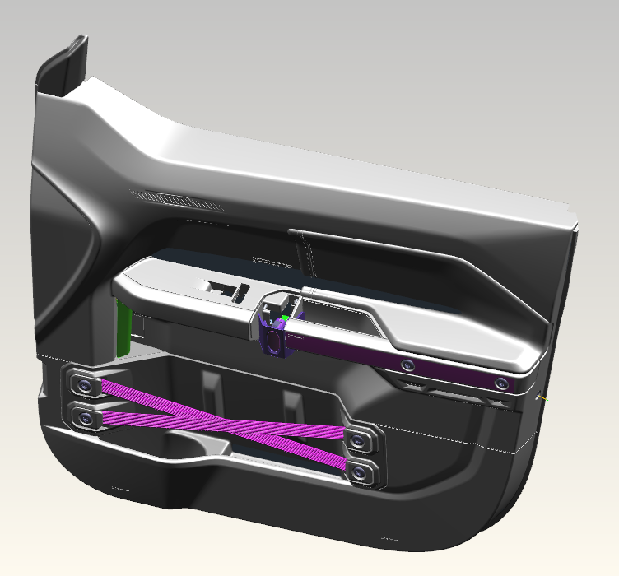

Slide 3
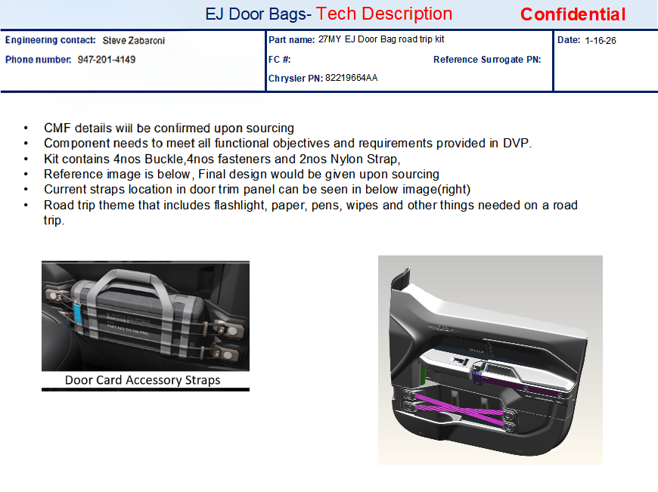

Slide 4


Slide 5
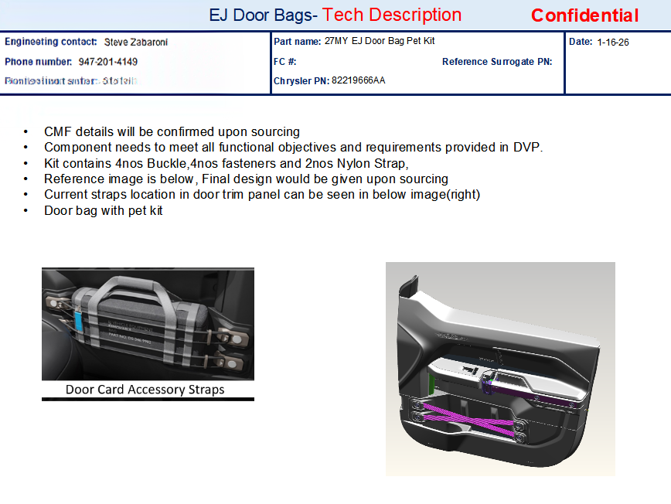

Slide 6
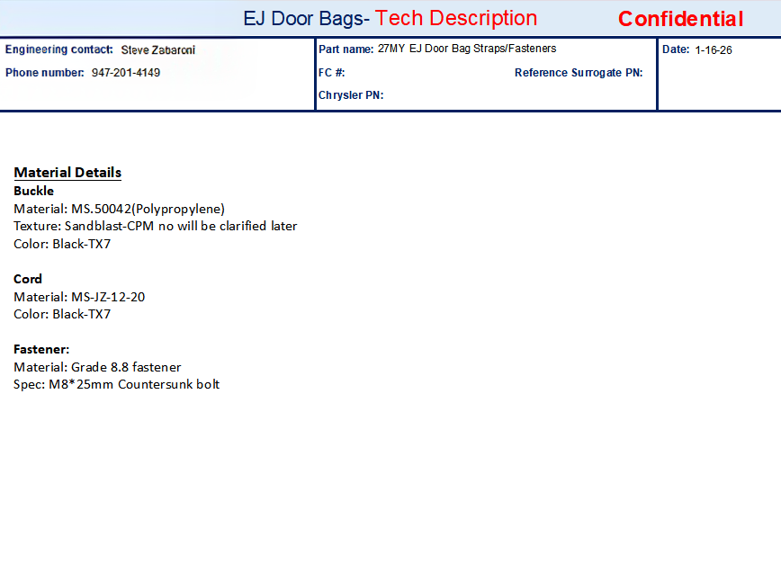

Slide 7
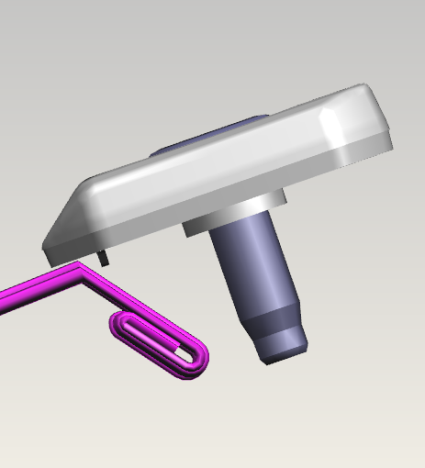
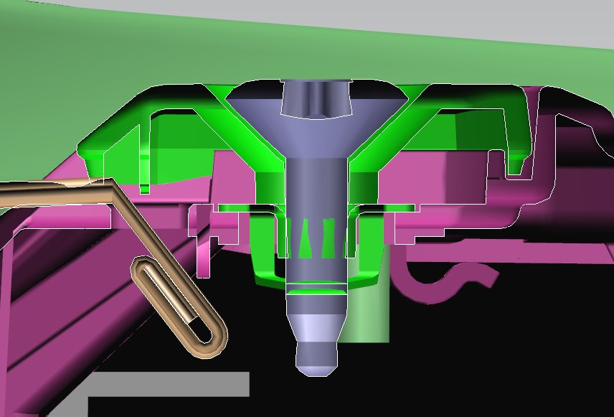
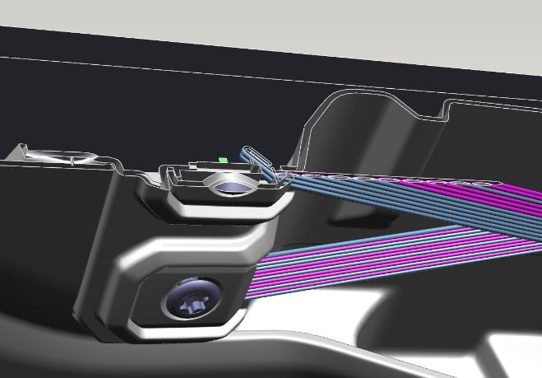
KIT BOM
S.No | Part name | Qty | Box dim.
1 | Buckle | 4 | 50*15*40
2 | Nylon Cords/Straps | 2 | 410*87*37
3 | Fastener | 4 | M8*25
4 | I-sheet | 1 | NA
( Dimensions are (in ‘mm’) approximate and for referential purposes only)
Attachment method of current buckle & straps to Door for reference in below images,

